Slide 1
Hyper-V: A Great Platform For Hosting Linux Workloads
Dr. K. Y. Srinivasan
Partner Architect
Server And Cloud Division
Microsoft Corporation
Redmond WA
kys@microsoft.com

Slide 2
Agenda
Linux On Hyper-V
  Our Linux Journey
  Key Areas Of Focus
  Legacy Distro Support

Slide 3
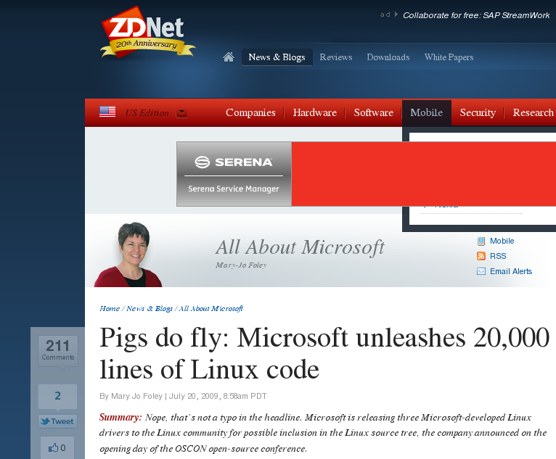

Slide 4
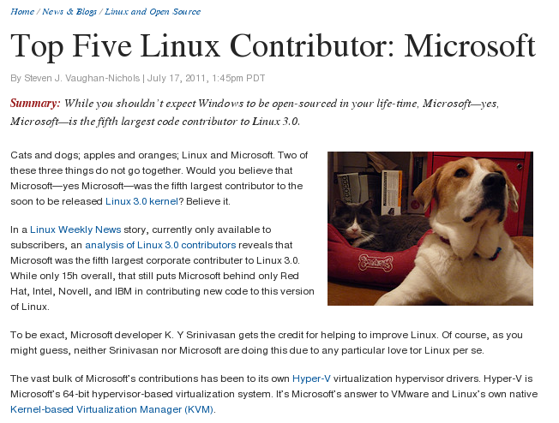

Slide 5
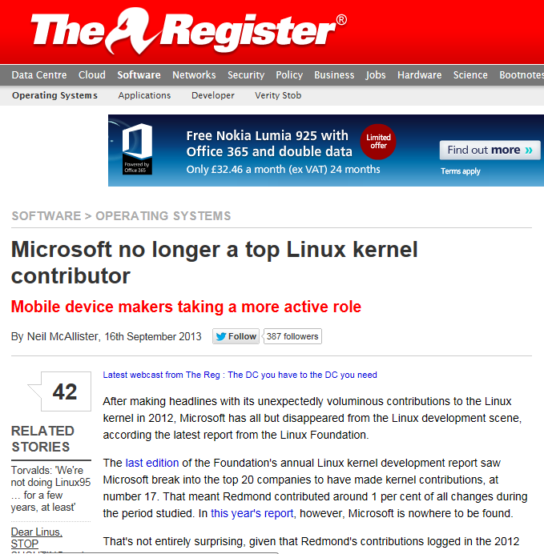

Slide 10
Current State
MSFT Linux code contribution has reached a steady state
Linux community very comfortable working with us on supporting Linux on Hyper-V
Hyper-V support fully integrated in the upstream kernel
Linux Kernel community seeks our feedback/input on a variety of issues

Slide 11
Current State
Hyper-V support broadly available in a range of commercial Linux Distributions:
  Ubuntu
  SLES
  RedHat
  CentOS
  Other RedHat/Debian derivatives
  Oracle Linux
  Chinese Distributions

Slide 12
Areas Of Focus
Performance/Scalability
Manageability

Slide 13
Performance Enhancements
Updated VMBUS Protocol:
  Optimized Host/Guest Signaling
  Scalable interrupt delivery architecture in the guest
  Multi-channel support for high performance I/O
Optimized drivers for performance critical I/O
  Azure specific optimizations
  Storage including Fibre Channel support
  Networking including VRSS support

Slide 14
On Local Hyper-V Server
Note:
Server VM CPU: 8 vCPUs of E5-2690 @2.90GHz, on one NUMA node

Slide 15
On Azure G5
Note:
VM CPU: 32 vCPUs of E5-2698B v3 @ 2.00GHz, on two NUMA nodes

Slide 16
On Azure D14
Note:
VM CPU: 16 vCPUs of E5-2660 0 @ 2.20GHz, on two NUMA nodes

Slide 17
Azure D14, vs AWS c3.8xLarge
Note:
Azure D14 CPU: 16 vCPUs of E5-2660 0 @ 2.20GHz, on two NUMA nodes
AWS c3.8xLarge CPU: 32 vCPUs of E5-2680 v2 @ 2.80GHz, on two NUMA nodes

Slide 18
Test Configure
Local HyperV server:
  Host:
    WS2012 R2 with Mellanox ConnectX-3 PRO (40G Ethernet)
    DynamicVMQ disabled; vRSS enabled
    Client side: alid-722-blue, E5-2670 @2.60GHz
    Server side: alid-724-blue, E5-2690 @2.90GHz
  Guest VM:
    8 vCPUs; 8G Memory; 40G Ethernet
Azure:
  G-Series: E5-2698B v3 @ 2.00GHz; 40G Ethernet on hosts
    G5: 32 vCPUs, 32Gbps
    G4: 16 vCPUs, 16Gbps
    G3: 8 vCPUs, 8Gbps
    G2: 4 vCPUs, 4Gbps
    G1: 2 vCPUs, 2Gbps
  D14: CPU: 16 vCPUs of E5-2660 0 @ 2.20GHz; Memory: 112 G; 10G Ethernet on hosts (8Gbps on VMs)
AWS
  C3.8xLarge: CPU: 32 vCPUs of E5-2680 v2 @ 2.80GHz; Memory: 60 G; 10G Ethernet
OS:
  Windows: WS2012 R2
  Linux on Hyperv/Azure: SLES12 + 4.1.0-rc6-next-20150604
  Linux on AWS: SLES12
Test Tools:
  Windows: NTTTCP (v5.28).
  Linux: iperf 3 (v3.0.5). By default, one iperf3 instance will host 64 connections for large number of connections. If noted, then it will host 4 connections (on Azure G5, Local HyperV).
Test Date: May 28 – June 22, 2015

Slide 19
Premium D-Series Azure high-performance, low-latency storage
VM SKU: Standard_DS14
Premium Storage Type: P30
Disk Config: RAID 0 (12 x 1023gb)
HostCaching: None

Slide 20
Standard_DS14
Hardware configuration
General Purpose Compute: Standard tier
Storage: Solid State Drives (SSDs)
Instance | CPU Cores | RAM (GB) | Temp Disk (GB) | Max Disk (1023 GB each) | Cache Size (GB)
Standard_DS14 | 16 | 112 | 224 | 32 | 576

Slide 21
Contd Standard_DS14

Slide 22
Contd Standard_DS14

Slide 23
Contd Standard_DS14

Slide 24
Contd Standard_DS14

Slide 25
Premium G-Series Azure extensive high-performance, low-latency storage
VM SKU: Standard_GS5
Premium Storage Type: P30
Disk Config: RAID 0 (40 x 1023gb)
HostCaching: None

Slide 26
Standard_GS5
Hardware configuration
General Purpose Compute: Standard tier
Storage: Solid State Drives (SSDs)
Instance | CPU Cores | RAM (GB) | Temp Disk (GB) | Max Disk (1023 GB each) | Cache Size (GB)
Standard_GS5 | 32 | 448 | 896 | 64 | 4224

Slide 27
Contd Standard_GS5

Slide 28
Contd Standard_GS5

Slide 29
Contd Standard_GS5

Slide 30
Contd Standard_GS5

Slide 31
Storage Performance on CPS
Linux VM performs closely to Windows VM on CPS
Infrastructure Setup
  112 VMs deployed (8 VMs/Host * 14 Hosts)
VM Configuration
  Small VM Size
  1 vCPU
  1.75 GB RAM
  Fixed OS Disk (VHDX) of 40GB over SSD
Workload
  IO Size: 4K
  100% Random Read
  Queue Depth: 1, 2, 4, 8, 16, 32
  Un-buffered IO

Slide 32
RDMA/Infiniband for Azure
Parent partition
Linux
guest
Customer HPC app with HPC libraries
=
Existing Azure-specific code
Mellanox
Infiniband library
=
Virtual Switch
Extension
for Infiniband
Existing 3rd party code
User
Control
Data
=
New code for Linux
Kernel
Linux Infiniband
framework
Mapped
Mellanox
NIC
Physical driver
Hyper-V synthetic
Infiniband driver
Hyper-V
VMBus
…
Physical
host
Mellanox
NIC

Slide 33
Linux RDMA Support
Throughput and Latency from PingPong test

Slide 34
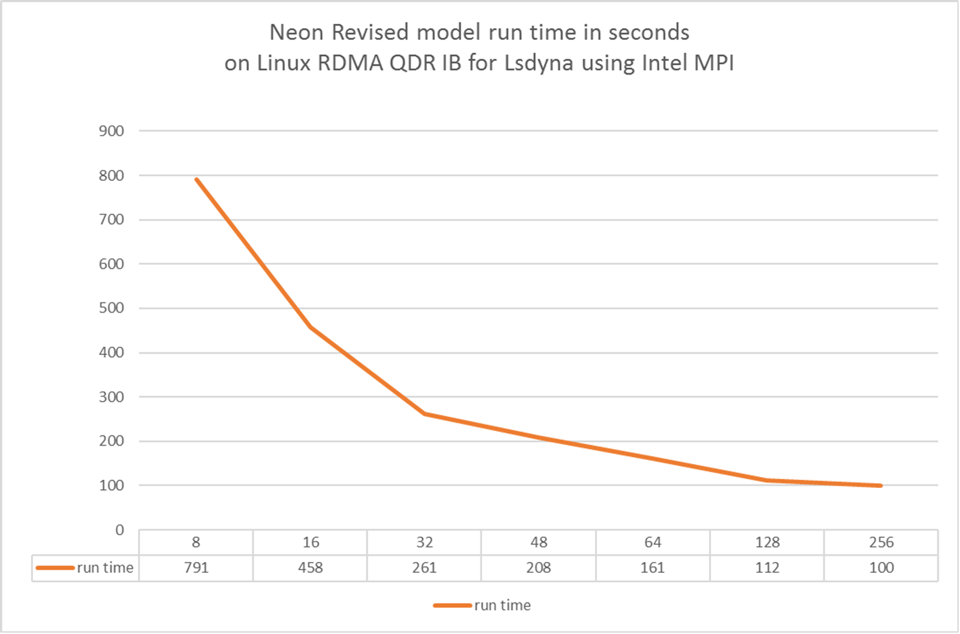

Slide 35
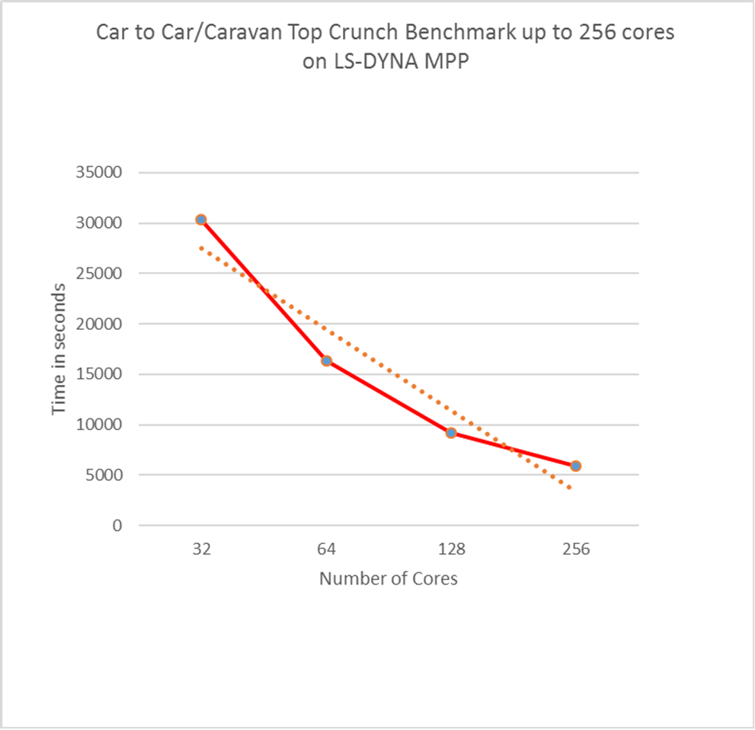

Slide 36
SR-IOV
Architectural Principles
  Windows PF driver (unmodified)
  Linux VF drivers (minimal modification)
  VF instances presented as independent links in the guest.
  Linux bonding driver used for failover management

Slide 37
Manageability
Full support for Dynamic Memory in Linux guests
Dynamic LUN resizing
Host initiated, “File System Consistent” backup of Linux guests
VM Replication Support For Linux
Linux as a “Gen 2” on Hyper-V
Powershell For Linux
VMSock – Host/Guest communication

Slide 38
Linux Backup
Support for a new architecture for block-level backup:
  Linux currently does not have the VSS framework
    Applications are not involved in backup
  Fully automated solution for Linux (unlike the VmWare solution)

Slide 39
Linux As A Gen 2 VM
UEFI based firmware stack
  SCSI Boot
  UEFI Secure boot
Modern platform
  No legacy device emulation
  Customized for virtual environments
  Enhanced Security – minimize DOS attacks

Slide 40
Legacy Distro Support
MSFT supported, installable driver RPM that supports:
  RHEL 5.5, 5.6, 5.7 and 5.8
    RHEL 5.9/5.10 shipping with Hyper-V support
  RHEL 6.0, 6.1, 6.2 and 6.3
    RHEL 6.4/6.5 shipping with Hyper-V support
  Corresponding CentOS and Oracle Linux releases
  Support for kernels as old as 2.6.16

Slide 41







LIS Distribution & Support
Microsoft
developers
LIS for Hyper-V
LIS for Hyper-V
Linux kernel main
Linux community
MS
download
center
Customer installs LIS
Support issues flow in reverse direction
Distro vendors
. . . .
Customer servers w/Hyper-V
Linux distro w/LIS

Slide 42
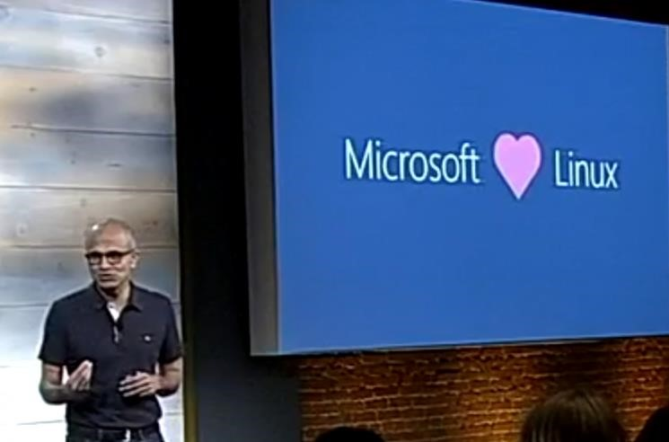
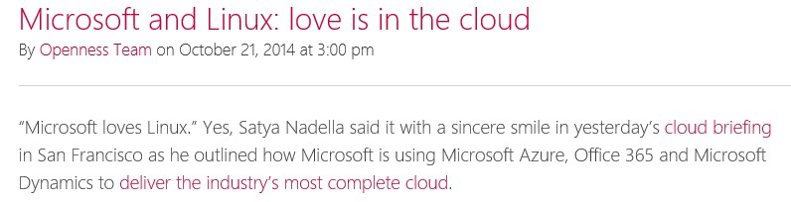

Slide 43
QUESTIONS?
kys@microsoft.com

